Slide 1
S6: Trees
CS1101S AY20/21 Sem 1
Studio 2D
Lee Wei Min
Notes:
Add studio name

Slide 2
Contents
Higher order list processing
Trees

Slide 3
Info
Not core:
Programming language processing
CPS

Slide 4
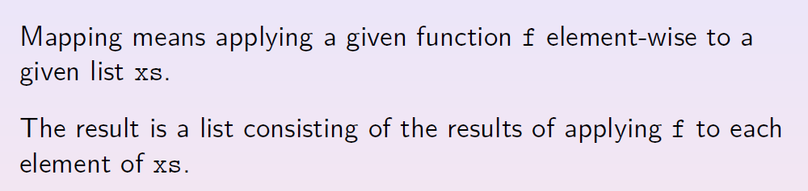
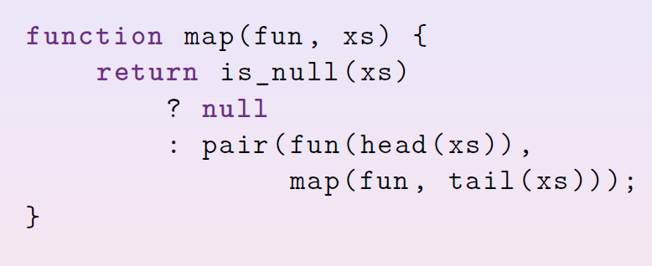
Map

Slide 5
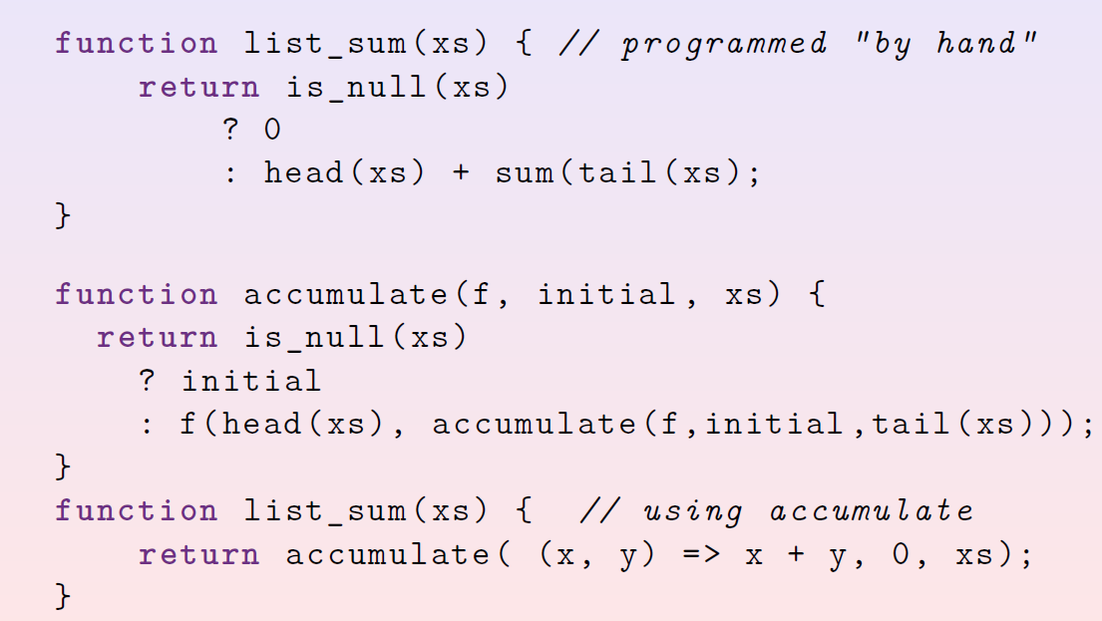
Accumulate

Slide 6
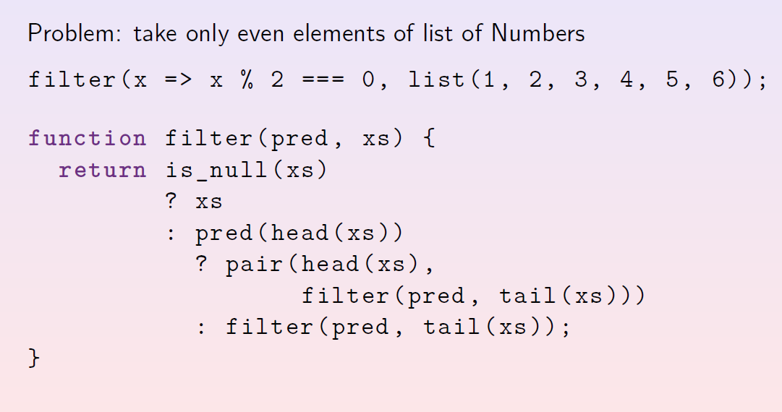
Filter

Slide 7
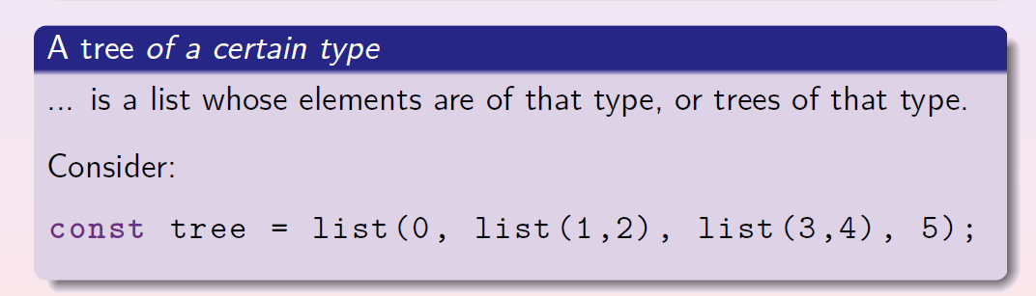
Trees

Slide 8
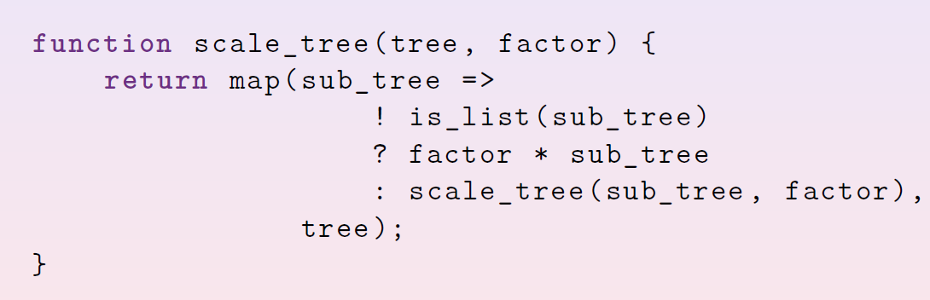
Trees

Slide 9
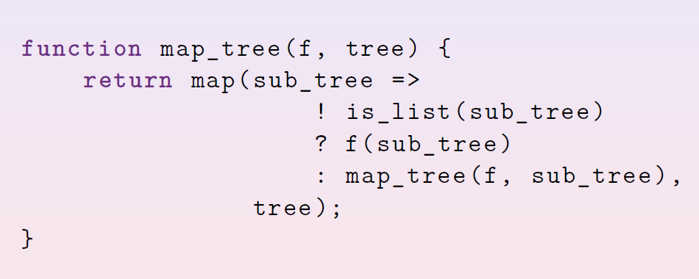
Trees: Map

Slide 10
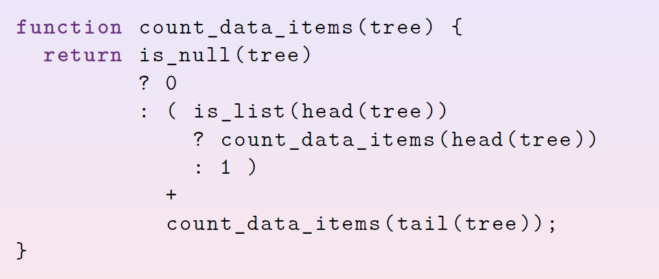
Trees: Counting

